Slide 1
DSO 545 - Dashboard
Factors affecting the Fertility Rate of the OECD Countries

Slide 2





Our Team
Wenjing (Leah) Xia
Jinglei (Lesly) Liu
Suixin (Spencer)
Wang
Rakshit Jha
Krish Vora

Slide 3
TABLE OF CONTENTS
01
02
03
Abstract
Introduction
Exploratory Data Analysis
04
05
Dashboard
References

Slide 4
01
Abstract

Slide 5
Abstract of Our Project -
Factors affecting the Fertility Rate in the OECD Countries
The fertility rate is a critical indicator of a country’s social and economic development. Each country needs a certain level of fertility rate to keep its population constant. Our group project tries to study the trend of the fertility rate and the potential factors that could impact the fertility rate. We narrow down the research scope to the Organization for Economic Co-operation and Development (OECD) countries and the time range is between 1980 to 2019. We chose two specific countries to focus on: Japan and the United States. Below are the findings:
The trend of the fertility rate for the OECD countries, Japan and the United States:
The average fertility rate of the OECD countries declined over the years, showing a downward trend.
The trend of the fertility rate of Japan follows the same trend.
The fertility rate of the United States first increased from 1983 and started to decline from 2007.
The correlation between factors and the fertility rate:
There was a negative correlation between GDP and the fertility rate for most of the years for the OECD countries, Japan and the United States.
There was a positive correlation between the Women Self-Employed Rate and the average fertility rate of the OECD countries for most of the years before 1994 and the correlation became negative afterwards.
There was a negative correlation between the Public Spending on Families and Children and the average fertility rate of the OECD countries before 1995 and the correlation became positive afterwards. The correlation between Public Spending on Families and Children and the fertility rate for Japan was different.
There was a positive correlation between the Marriage Rate and the fertility rate for the OECD countries, Japan and the United States.

Slide 6

02
Introduction

Slide 7
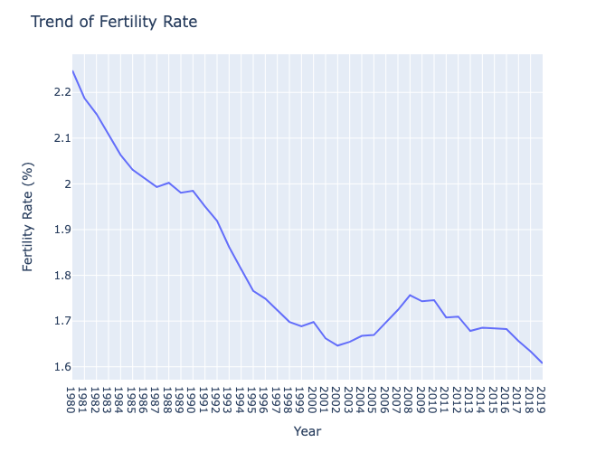
Introduction (Business Problem)
What is the fertility rate?
Fertility Rate is the average number of children a woman is expected to have over her lifetime. (oecd.org)
Trend of fertility rate (average fertility rate) of the OECD countries:
Why do we want to study the fertility rate?
A low fertility rate could cause social and economic problems
Hurt the country’s economy
Strain government budget
Threaten national security

Slide 8
Introduction (Dataset from OECD Website)
Fertility Rate: The average number of children a woman is expected to have over her lifetime.（oecd.org)
Child Support: Family benefits spending refers to public spending on family benefits, including financial support that is exclusively for families and children. （oecd.org)
GDP : Gross domestic product (GDP) divided by the country’s population. GDP is the standard measure of the value-added created through the production of goods and services in a country during a certain period. (oecd.org)
Gender Wage Gap: The difference between median earnings of men and women relative to median earnings of men. (oecd.org)
Household Income: Income available to households such as wages and salaries, income from self-employment and unincorporated enterprises, income from pensions and other social benefits, and income from financial investments (less any payments of tax, social insurance contributions and interest on financial liabilities). (oecd.org)
Household Spending: The amount of final consumption expenditure made by resident households to meet their everyday needs, such as food, clothing, housing (rent), energy, transport, durable goods (notably cars), health costs, leisure, and miscellaneous services. (oecd.org)
Women Education: Percentage of women in age 23-34 who completed the highest level of education. (oecd.org）
Women Self-Employed: Percentage of total employment whose gender is female and self-employed. (oecd.org)
Marriage Rate: The number of marriages during the year per 1000 people. (oecd.org)
Location and Country: The country name (abbreviation) of that country

Slide 9
03
Exploratory Data Analysis

Slide 10
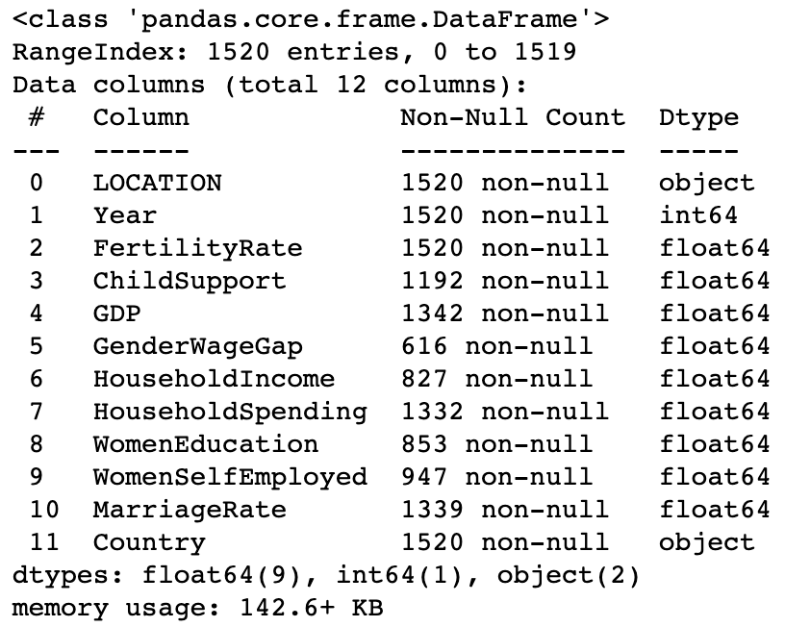
Data Overview

Slide 11
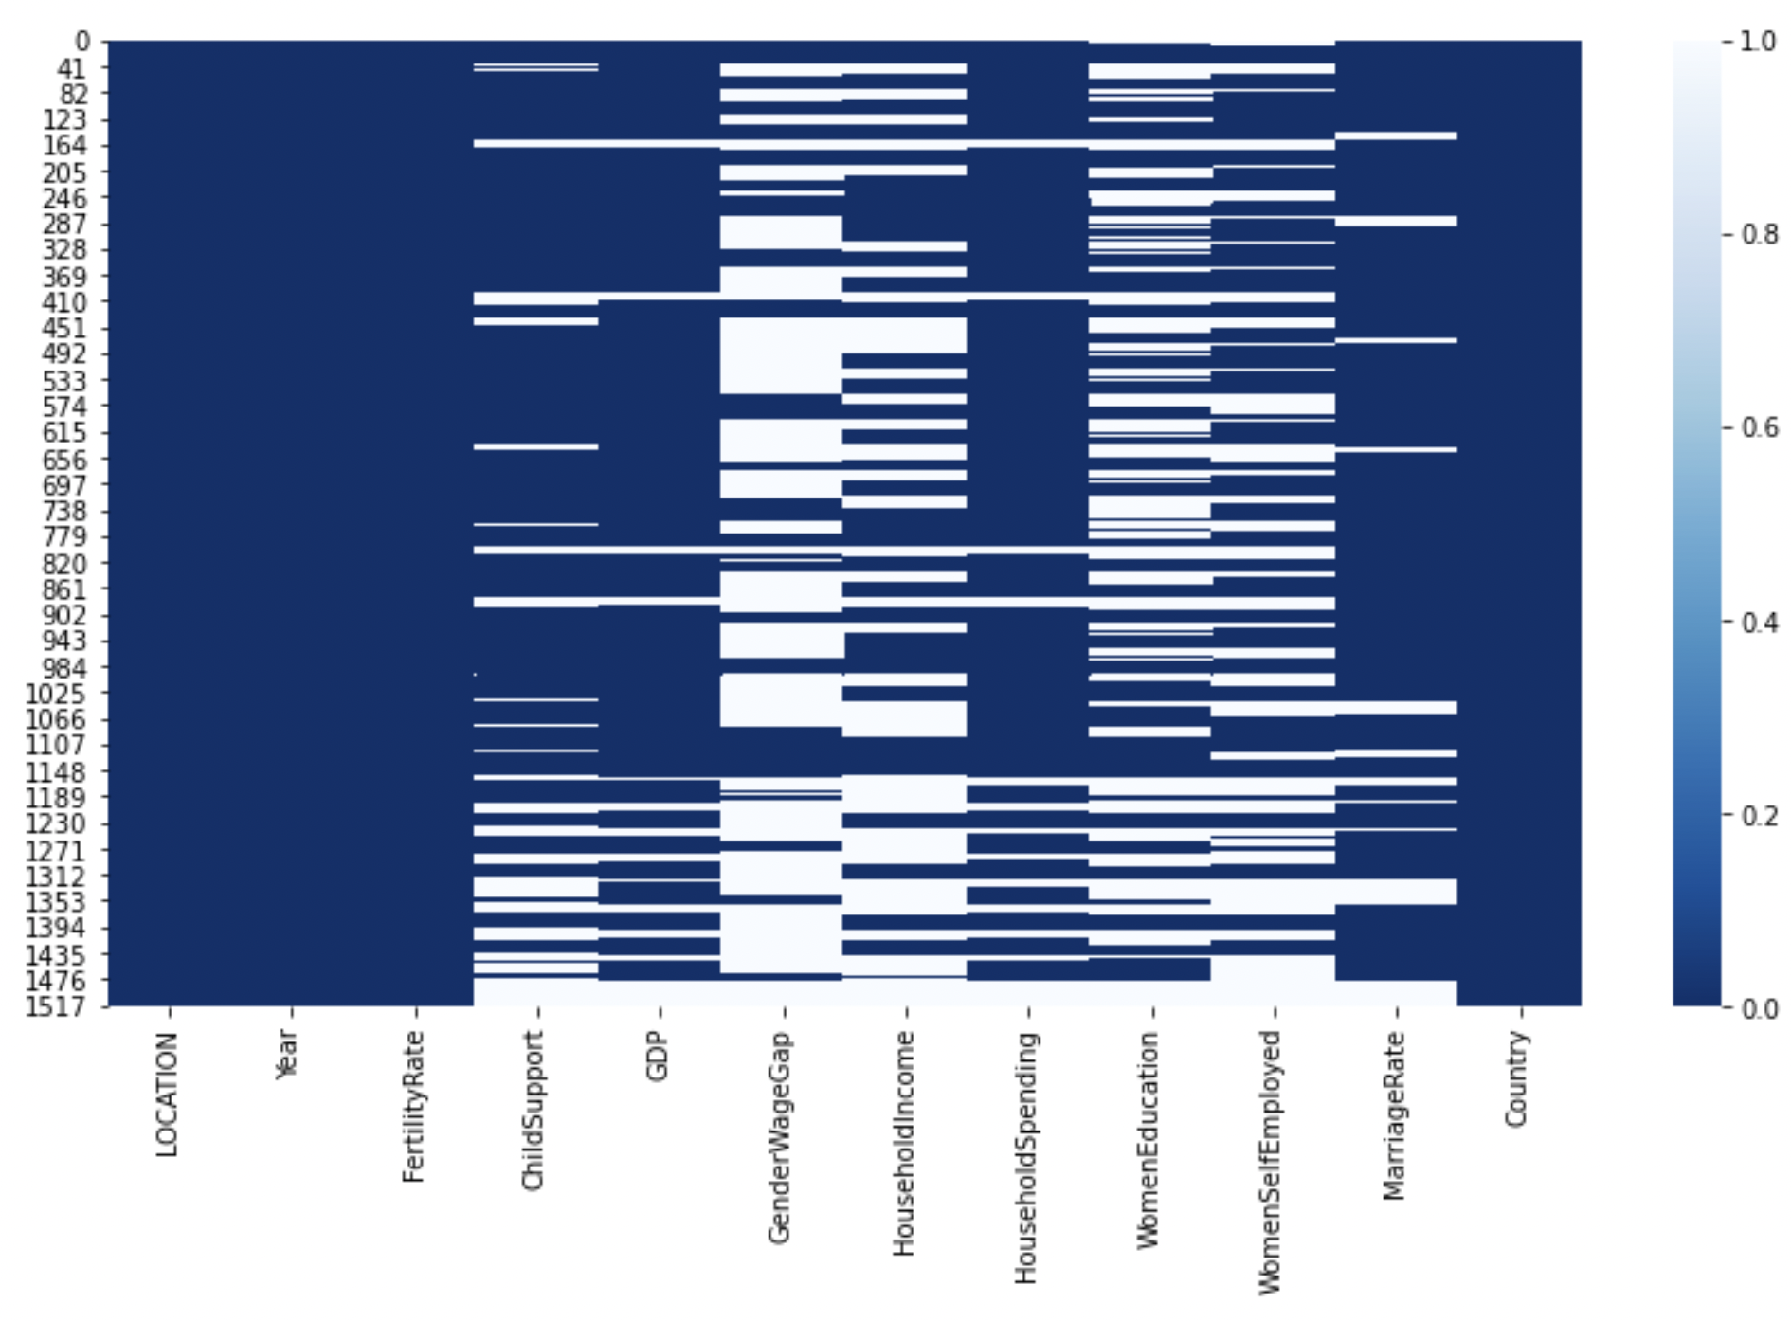
Null Values Heatmap

Slide 12
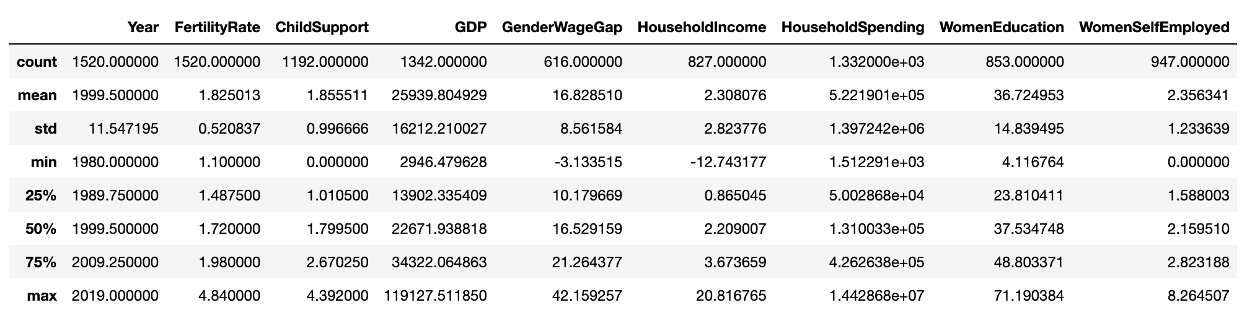
Data Description

Slide 13
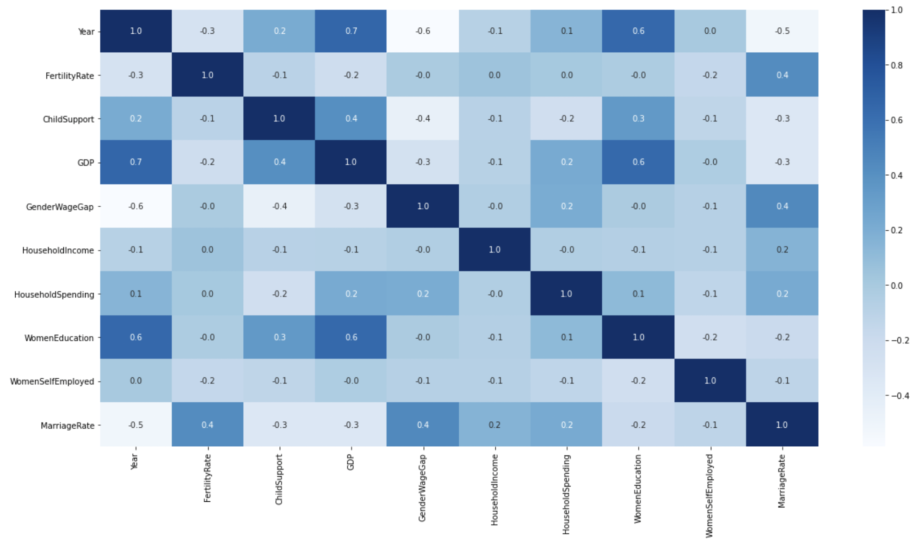
Correlation Heatmap

Slide 14
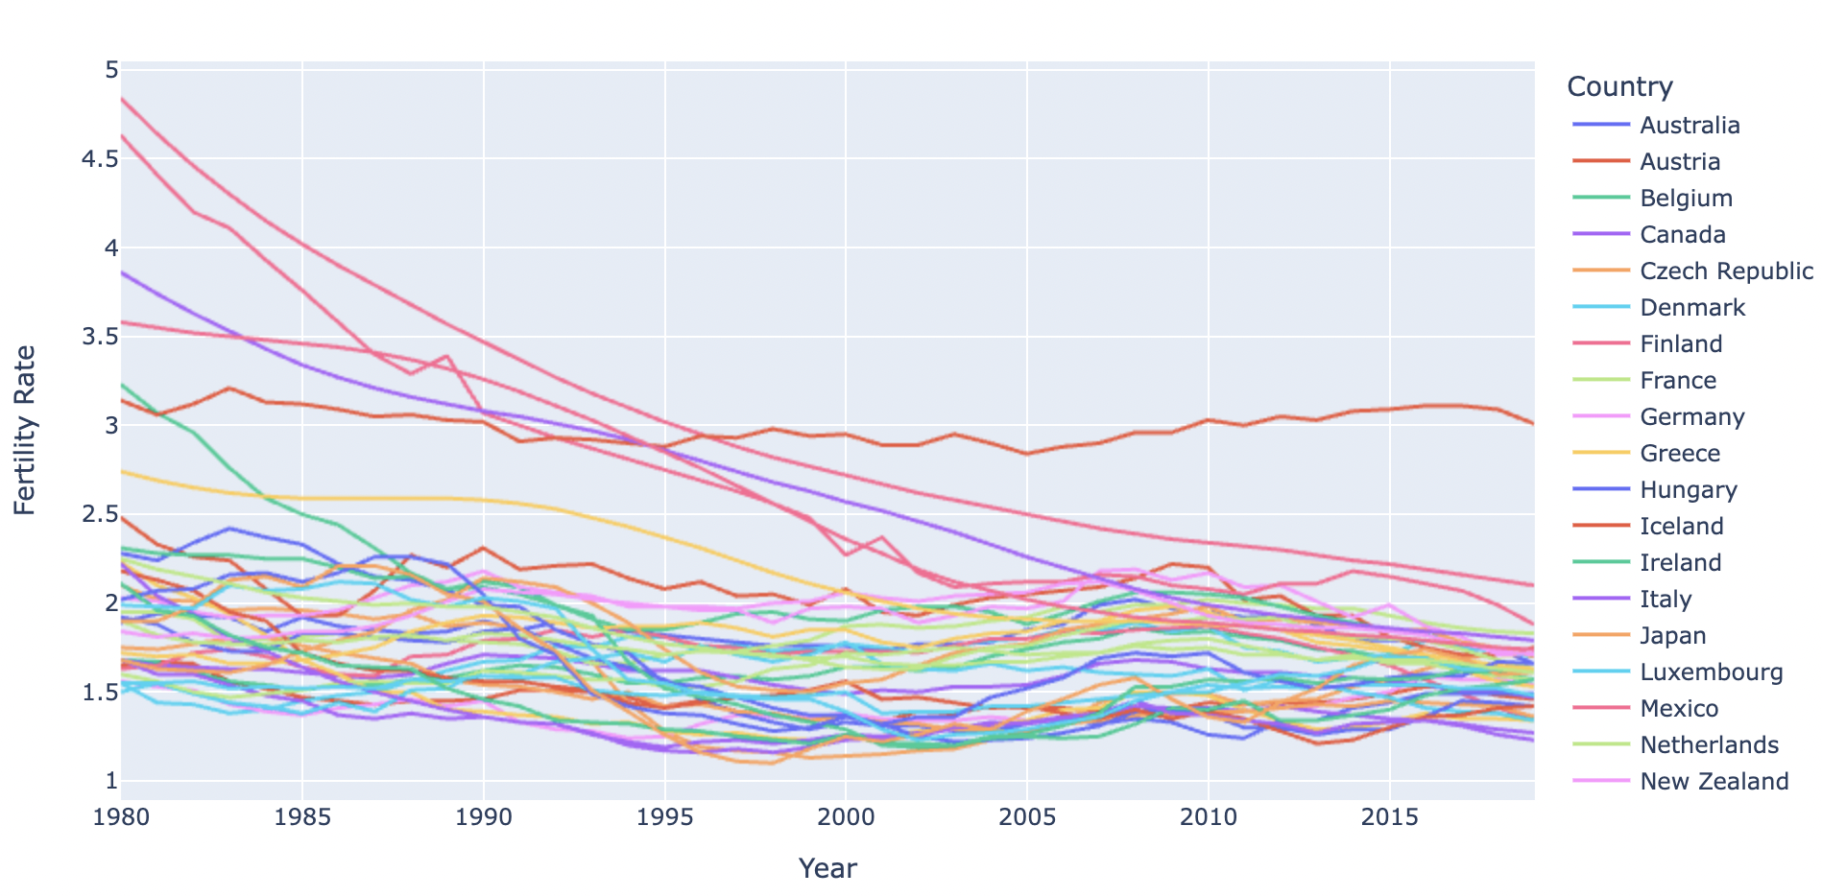
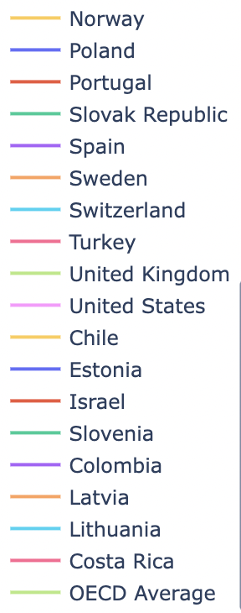
Fertility Rates For All OECD Countries

Slide 15
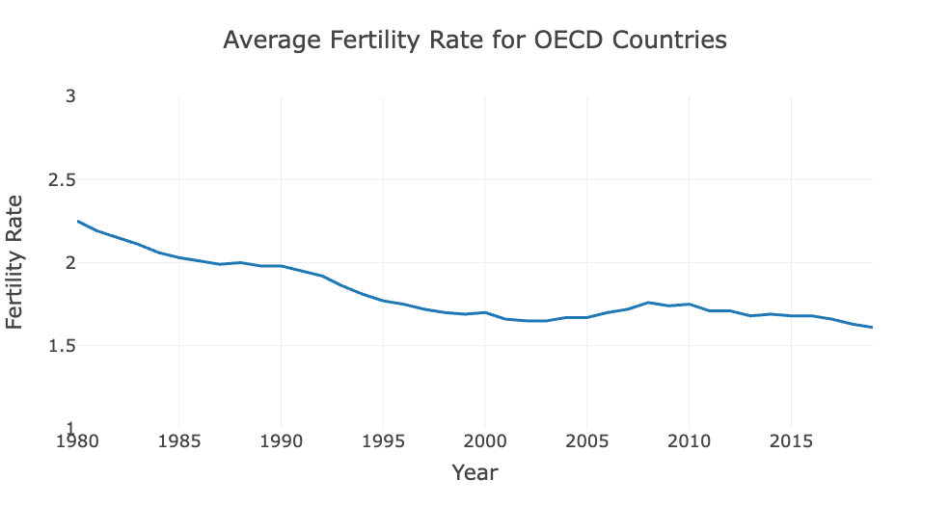
Average OECD Fertility Over The Years

Slide 16
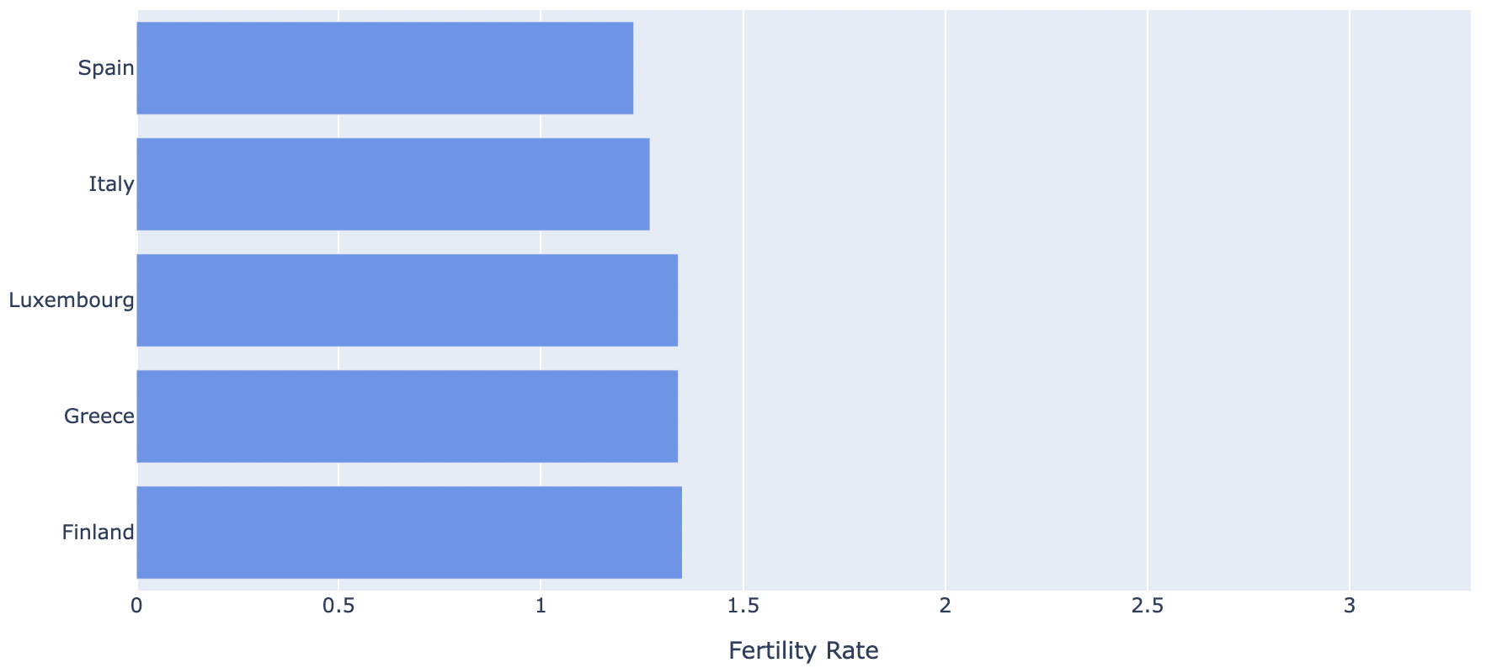
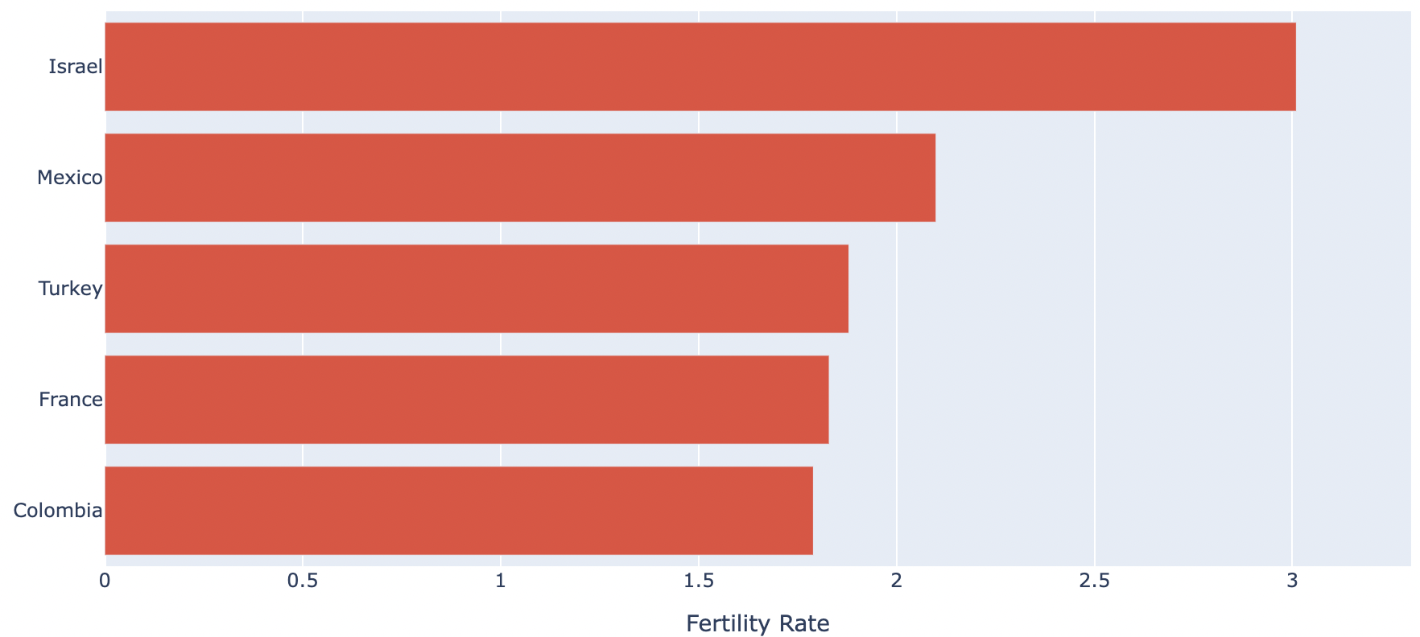
Highest And Lowest Fertility Rates (2019)
Lowest fertility rates for 2019
Highest fertility rates for 2019

Slide 17
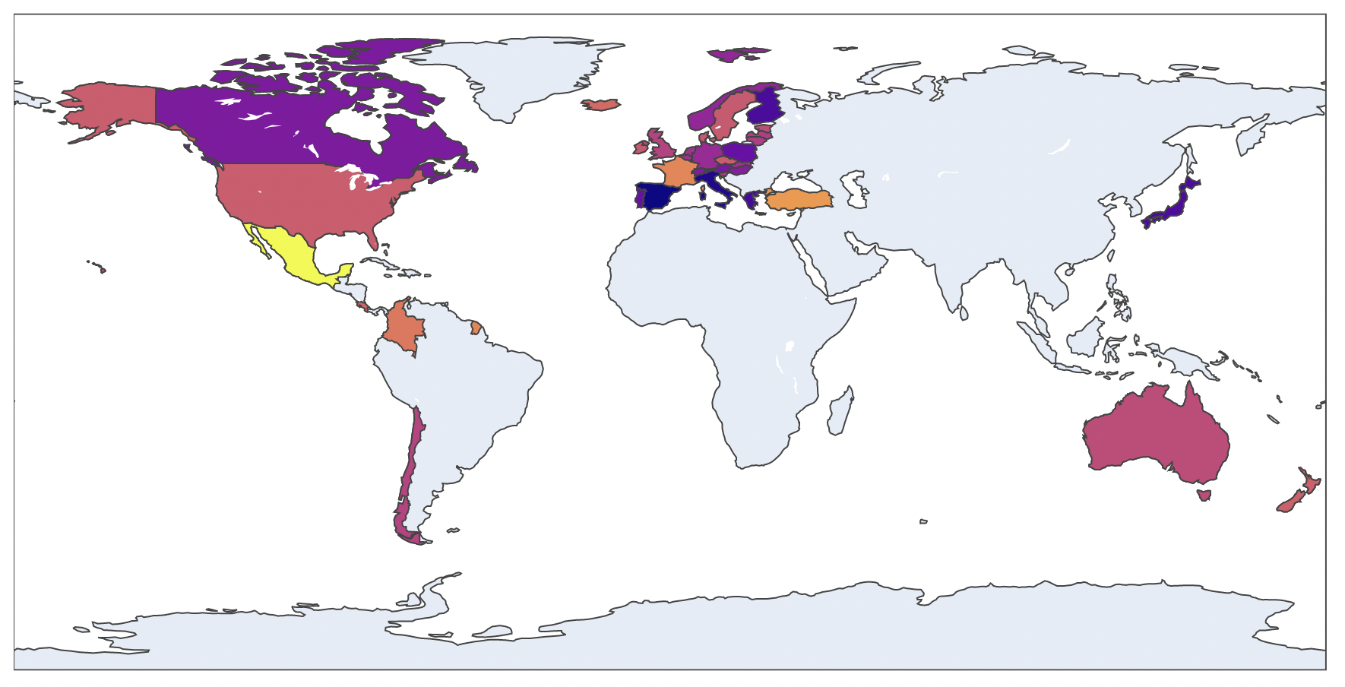
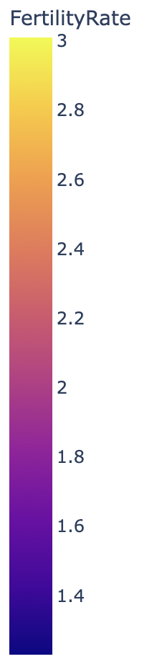
Fertility Rates Across The World (2019)

Slide 18
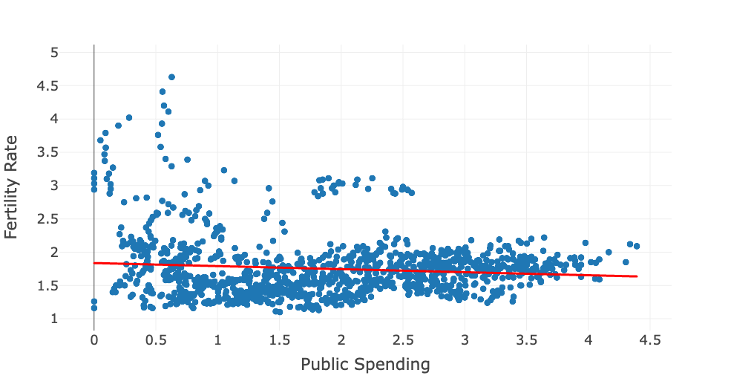
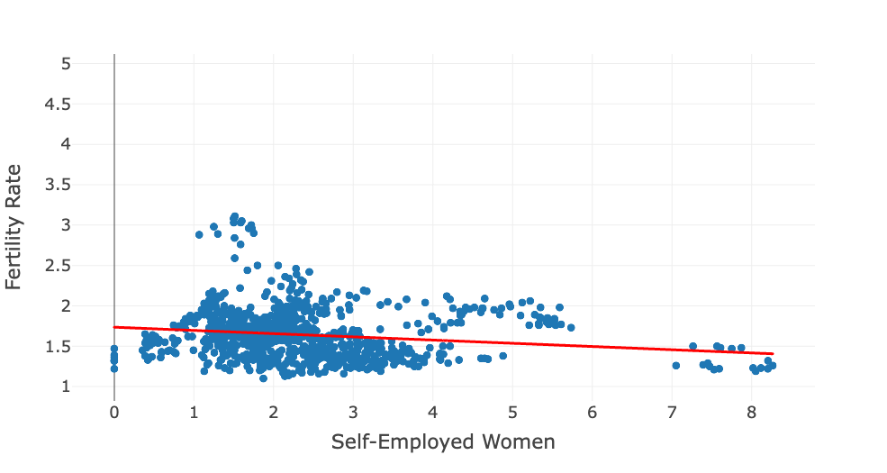
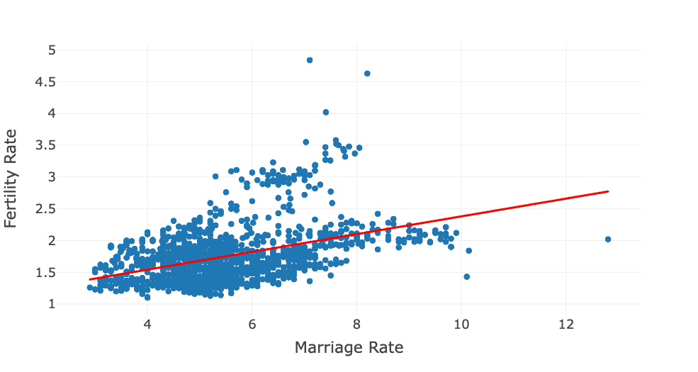
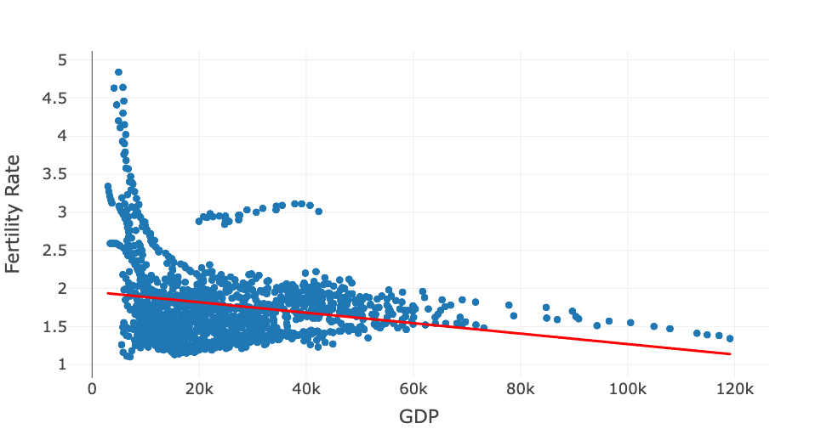
Factors Correlated With Fertility Rate

Slide 19
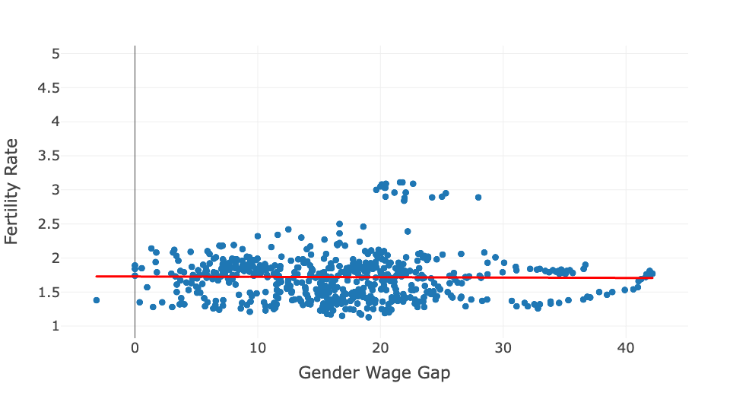
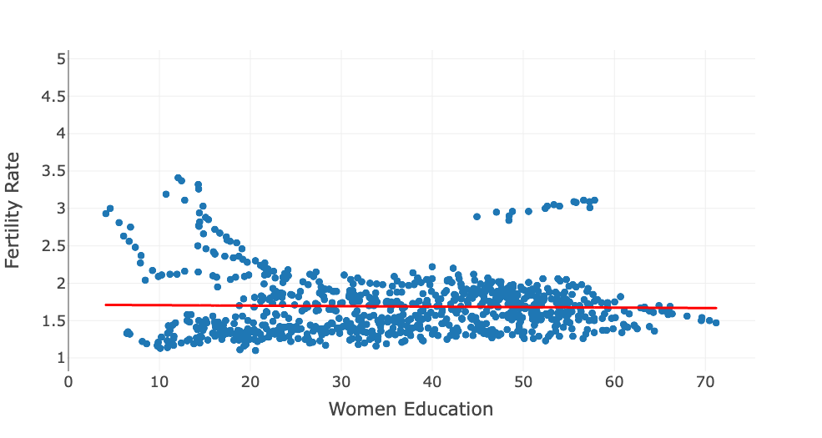
Factors Not Correlated With Fertility Rate

Slide 20
04
Dashboard

Slide 21
Overview
2 Dimensions
3 Filters
1 Color Theme
2 Sliders,
1 Dropdown Menu
2 Tabs
Blues & Red
17 Charts & Table
6 Key Metrics
13 Charts, 1 Table, 3 Boxes
4 Statistics, 2 trends
Examine data in term of countries or periods
Filter data by countries or periods or year
Blues for main body of data, and red for trendlines in scatterplots
Include 6 types
of charts
Compare data in term of countries or periods

Slide 22
Dashboard Design Principles followed
Consider audience and their needs: governments, health professionals, sociologists
Choose relevant KPI based on academic articles
Determine goals: help our audience keep track of the trend and identify associated factors
Use the right type of chart
Line chart: showcase trend
Map: direct view of geographic pattern
Lollipop: clear sense of fertility rates in different countries
Violin boxplot: illustrate distribution
Scatterplot: show potential correlations
Table: display specific data
Keep the design simple and easy to understand: add titles and labels
Limit the use of colors
Consistent with labeling
Use interactive element
Slider for users to select year or a range of years
Dropdown menu for users to select countries
Round numbers to 2 decimal places

Slide 23
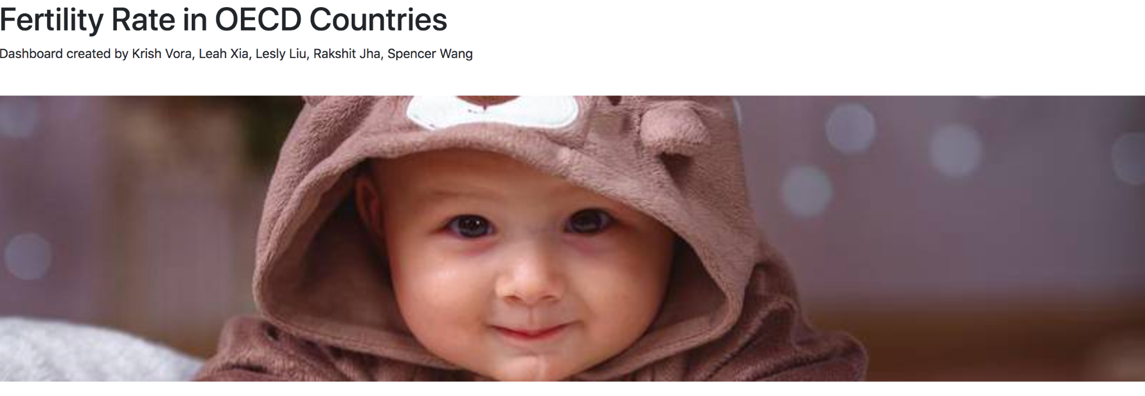
Dashboard

Slide 24
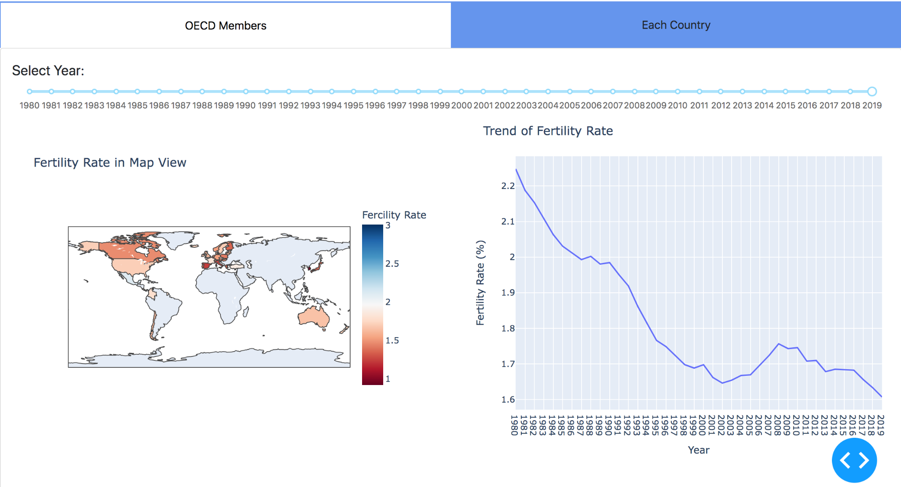
Dashboard

Slide 25
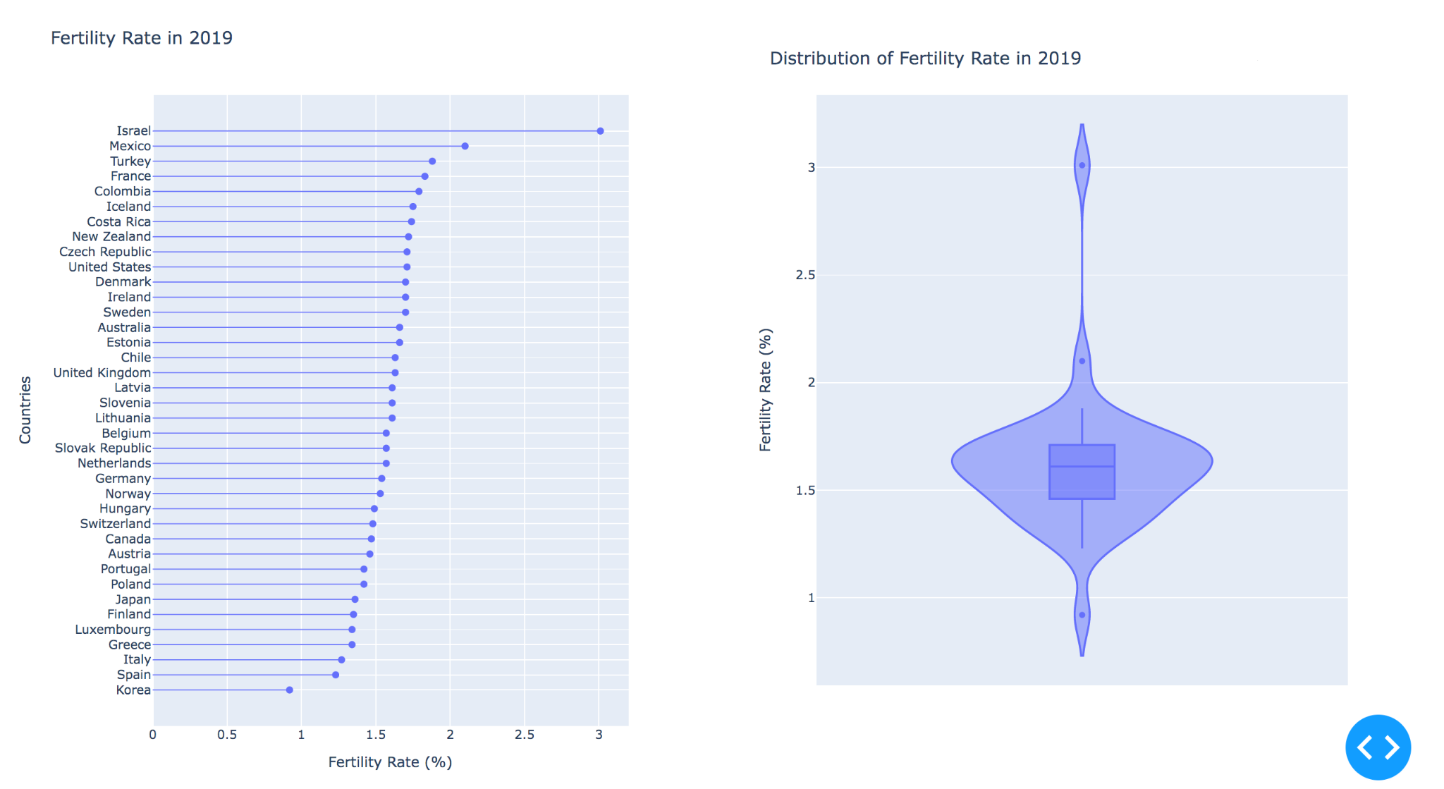
Dashboard

Slide 26
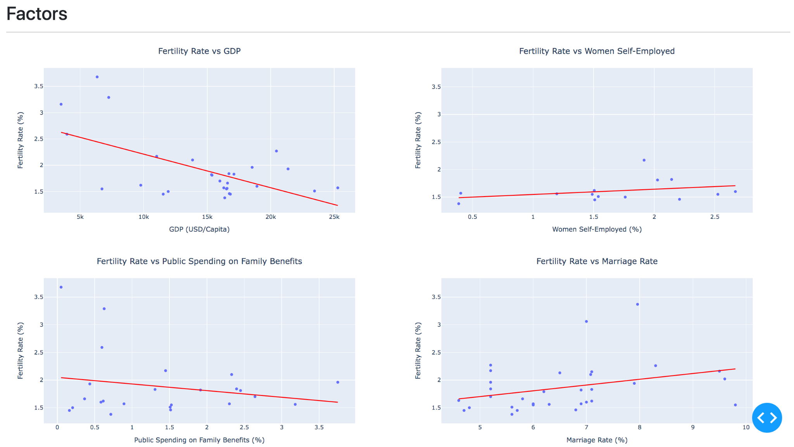
Dashboard
in 1988

Slide 27
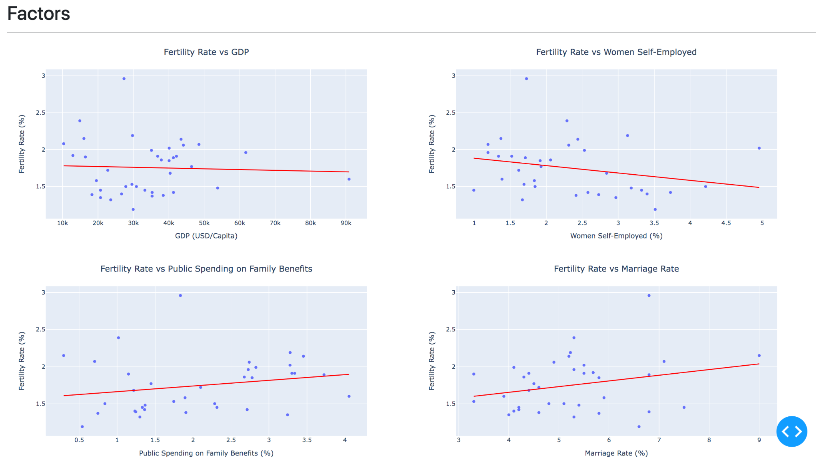
Dashboard
in 2008

Slide 28
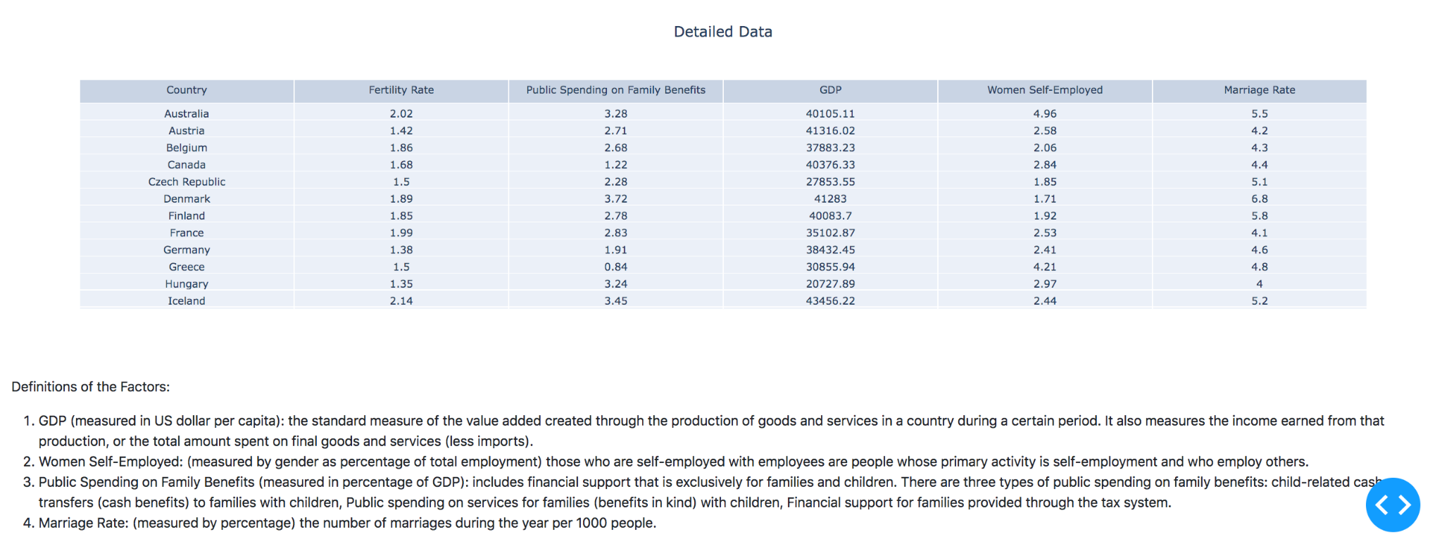
Dashboard

Slide 29
Principle No.1 Audience!
How well did my country perform compared to other countries?
How well did my country perform compared to itself?
Cross-sectional data provides direct comparison among OECD countries
Slider for year
Panel data provides direct time trend of the country of interest
Drop-down menu for countries and slider for time window

Slide 30
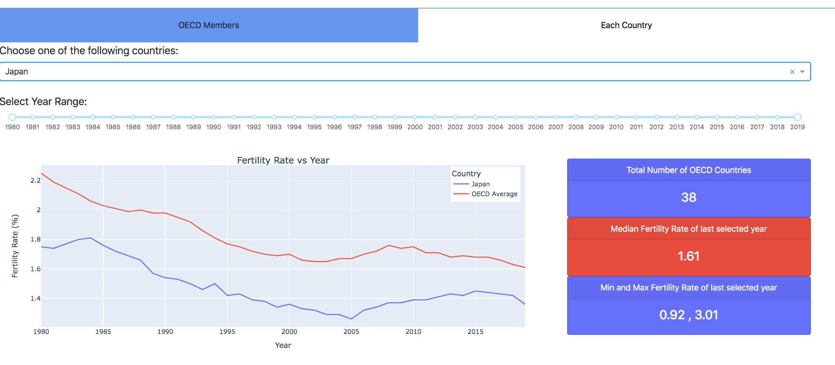
Dashboard
Japan

Slide 31
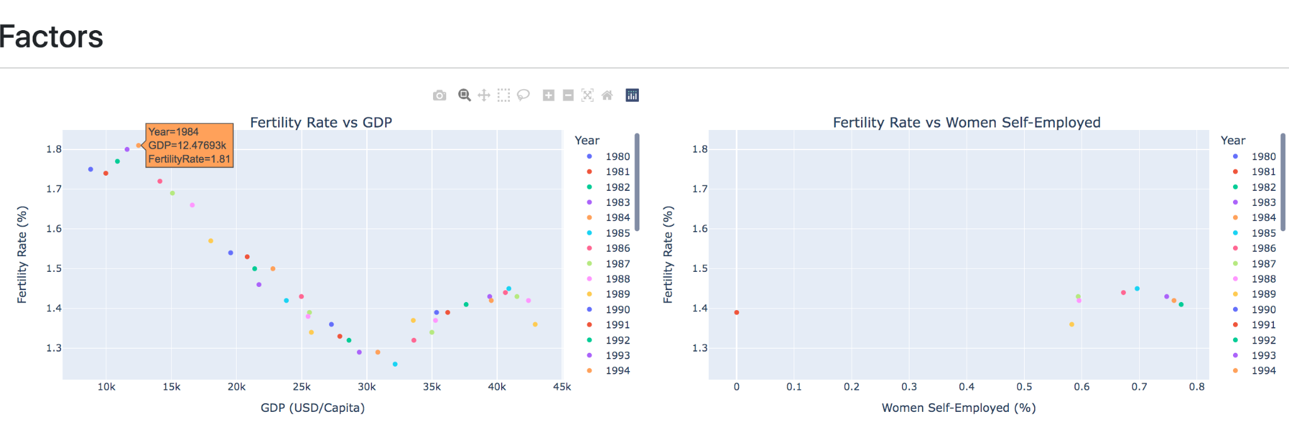
Dashboard
Japan

Slide 32
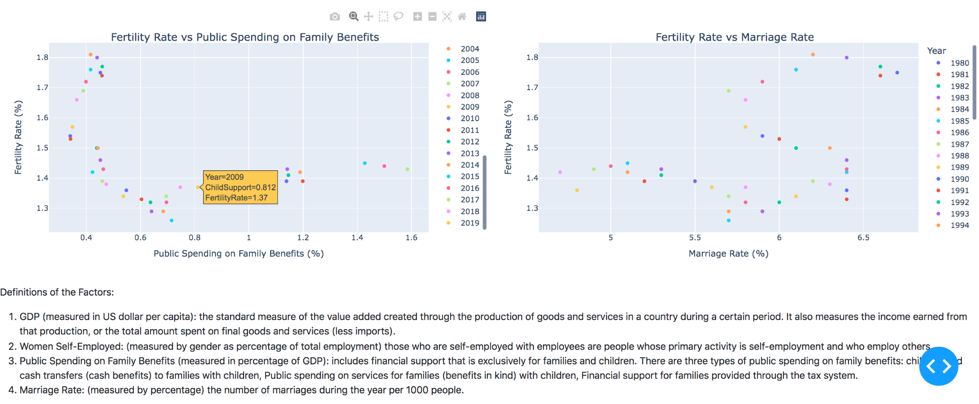
Dashboard
Japan

Slide 33
05
Reference

Slide 34
References
Murray, S. H. (2021, June 10). How Low Can America’s Birth Rate Go Before It’s A Problem? [Slides]. FiveThirtyEight. https://fivethirtyeight.com/features/how-low-can-americas-birth-rate-go-before-its-a-problem/
Lee, C. M., & Botto, K. (2021, June 29). Demographics and the Future of South Korea [Slides]. Carnegie Endowment for International Peace. https://carnegieendowment.org/2021/06/29/demographics-and-future-of-south-korea-pub-84817
Dropping fertility rates are a threat to the global economy. (2016, November 30). [Slides]. Business Insider. https://www.businessinsider.com/dropping-fertility-rates-will-affect-the-economy-2016-11?international=true&r=US&IR=T
Griffin, O. (2020b, February 11). Fertility crisis threatens Japan’s economy [Slides]. Raconteur. https://www.raconteur.net/global-business/asia/fertility-crisis-threatens-japans-economy/
OECD Data. (2021) Adult education level https://data.oecd.org/eduatt/population-with-tertiary-education.htm
OECD Data. (2021) Household spending https://data.oecd.org/hha/household-spending.htm
OECD Data. (2021) Gender wage gap https://data.oecd.org/earnwage/gender-wage-gap.htm
OECD Data. (2021) Gross domestic product (GDP) https://data.oecd.org/gdp/gross-domestic-product-gdp.htm
OECD Data. (2021) OECD Family Database https://www.oecd.org/els/family/database.htm
OECD Data. (2021) Household disposable income https://data.oecd.org/hha/household-disposable-income.htm
OECD Data. (2021) Adult education level https://data.oecd.org/eduatt/adult-education-level.htm
OECD Data. (2021) Family benefits public spending https://data.oecd.org/socialexp/family-benefits-public-spending.htm
OECD Data. (2021) Self-employed with employee https://data.oecd.org/entrepreneur/self-employed-with-employees.htm

Slide 35

THANKS!

